Slide 1
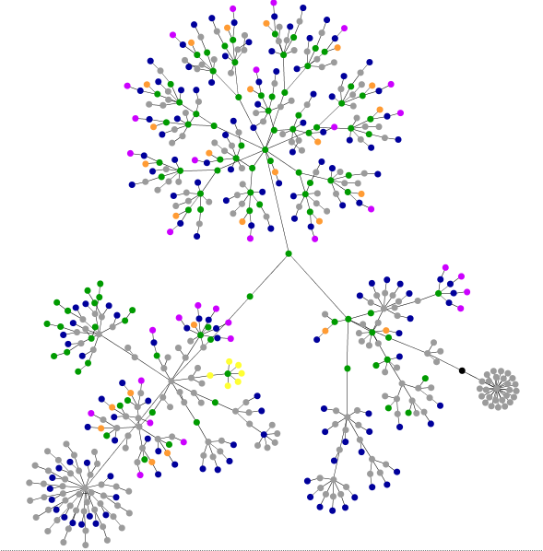
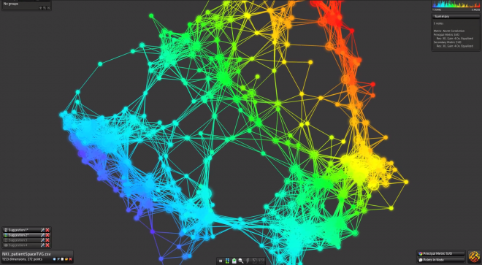
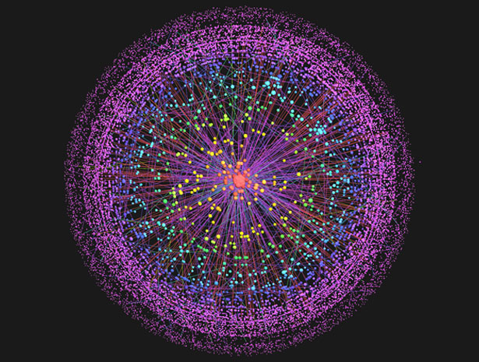
Visualizr

Slide 2
Team Members:
Visualizr
Umit Ceylan (PO)
Jamison Ball
Tyler Smith
Joe Rozo
Joey Lai
Kim Son Nguyen

Slide 3
Motivation
Free Open Source Visualization Software
Converting the Complex to the Simple

Slide 4
Goals
Set out to Achieve
Working as a team on a software project
Working with new technologies
Mobile Friendly
Have Achieved
User friendly
Multiple Visualization

Slide 5
Challenges
Start to use new technologies
Working as a group
Connecting different modules
Git merging
Agile Process

Slide 6
Technologies
Web2py/Python
D3 Library
JavaScript
HTML
CSS
Ajax
JQuery
JSon

Slide 7
Project Management
Trello
Slack
Git
Scrum

Slide 8
Things That We
Enjoyed:
Working with fellow CS people
Messing with Webpages and D3
Did not Enjoy:
The agile process
Trying to arrange meetings

Slide 9
Lessons Learned
What worked:
Version control and git (mostly worked)
Slack
Planning out stories
Playing to our individual strengths
What didn’t work:
Trying to do all the story points
Assigning one person per task
Assuming someone can learn something on their own quickly

Slide 10
Questions
?

